Slide 1

Prototipo de Sistema de Gestión Agrícola Sobre IoT Para una Finca de Uvero(Umbita, Boyacá).
TeleDomoFarm
Juan Pablo Guerra Porras 67000081
Asesor de trabajo Ing. Henry Zarate Zeballos.

Slide 2

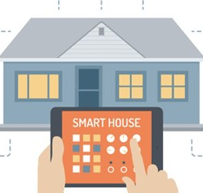
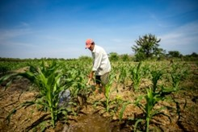
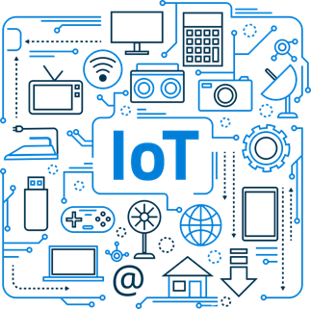
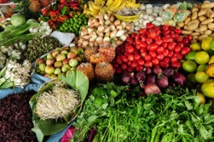

Planteamiento del Problema
Proceso
Sistema Automatizado
Faces o actividades que se desarrollan para la escalbilidad proyectada
Control adaptable para el ágil proceso en las funciones
Siembras
Interconexion Digital
Optimizacion de tiempo gracias al tratamiento de datos
Implementacion de Tecnologias Inteligentes para el AgroIOT
Cosechas
Ayudas Tecnologicas
Revisión Automatizada con las estadísticas del día
Creación de Flujos Instantáneos para el desarrollo y funcionamientos IoT

Slide 3
Pregunta Problema
¿Cómo monitorear, hacer seguimiento y reportes de los cultivos, el estado de las cosechas en una vivienda rural en Umbita Boyacá?

Slide 4

Objetivo General
Construir un prototipo de un sistema de información con servicios de domótica e IoT, que permita la gestión y el control de actividades agrarias, mediante la automatización del monitoreo de cultivos en una finca de la vereda de uvero en Umbita Boyacá.

Slide 5




01
Realizar el estado del arte de sistemas de monitoreo basados en IoT para actividades agrarias y su arquitectura de software.
Objetivos Específicos
02
Diseñar el prototipo de sistema de información a nivel de arquitectura de software, gestión de comunicaciones, gestión de sensores y actuadores para la recopilación y análisis de información.
03
Construir los módulos del prototipo del sistema de información de comunicación inalámbrica, gestión sensores y actuadores para la captura y análisis de datos en el cultivo.
04
Validar el funcionamiento del prototipo en un escenario de pruebas.

Slide 6
Ecuación de Búsqueda
TITLE-ABS-KEY ( "IoT" OR "IIoT" OR "embedded systems" OR "Domotic" OR "Moduls Wifi" OR "AgroIoT" OR "Sistemas Embebidos" OR "Domotica" OR modulos AND wifi )
1,917 document results

Slide 7
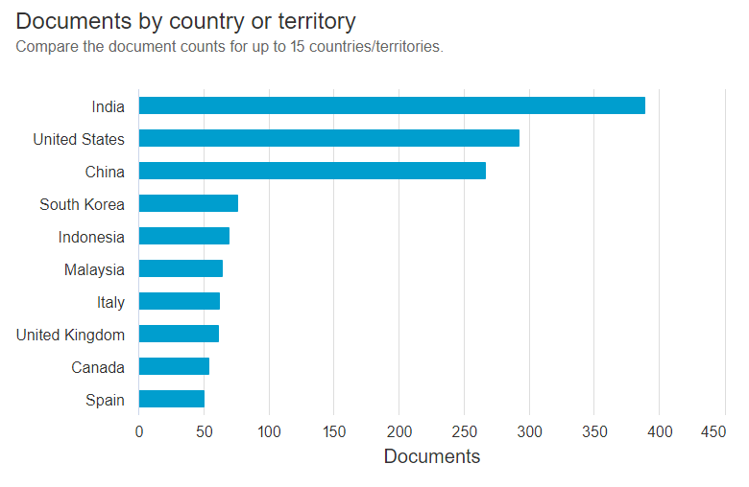
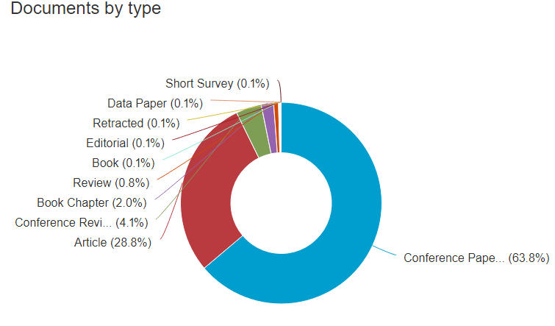
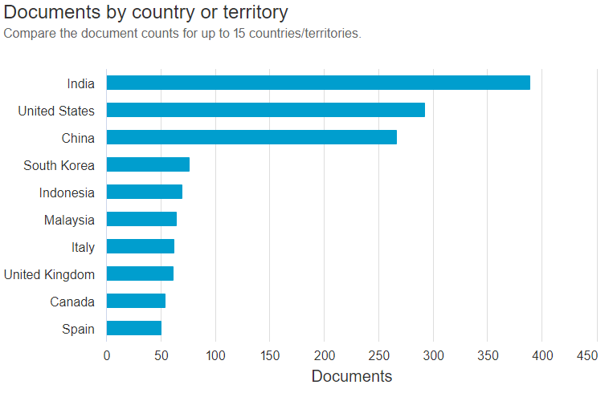
Análisis de documentos

Slide 8
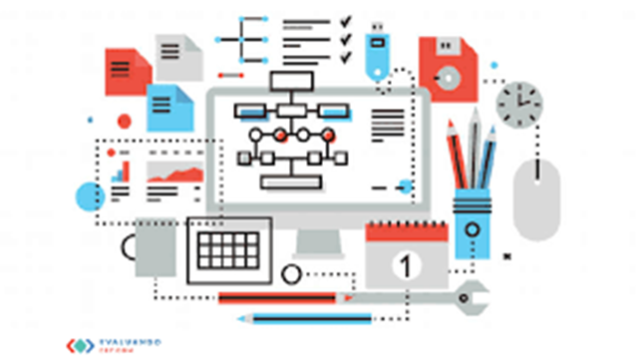
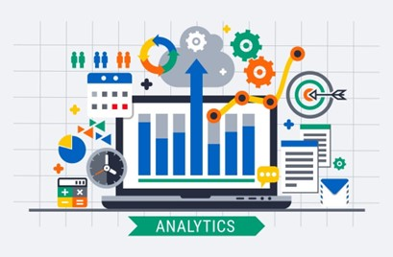
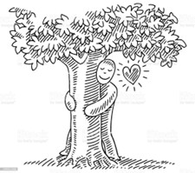

Justificacion
Falta de una gestión de datos
Sistema de información para la gestión agrícola
Gusto por la naturaleza
Optimización el lapso del tiempo en tareas agrícolas

Slide 9
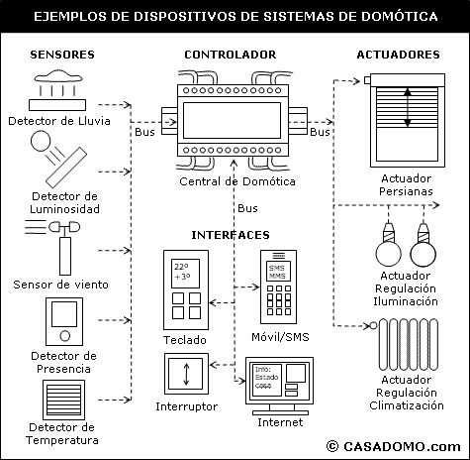
Estructura Domotica
Fuente: Blog de (García, 1993), Tecnologías Informáticas.

Slide 10
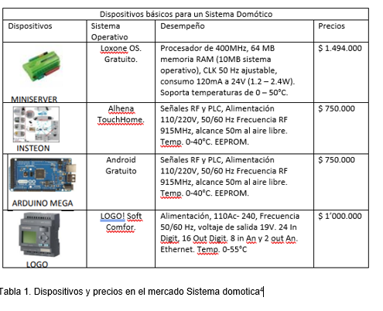
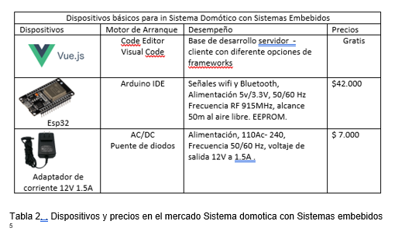

Slide 11
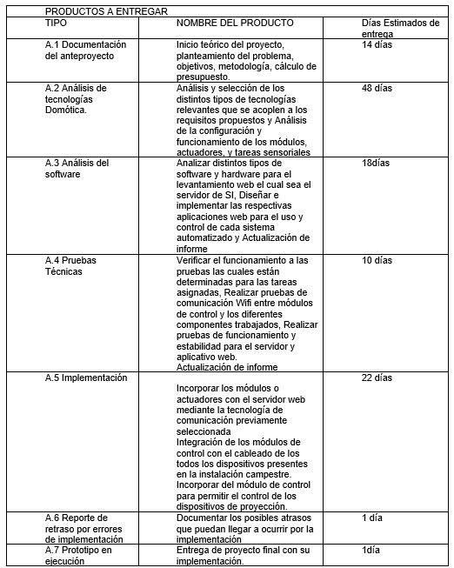
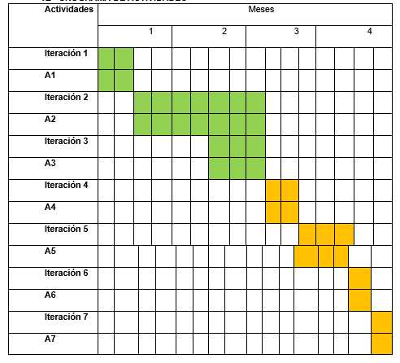

Slide 12
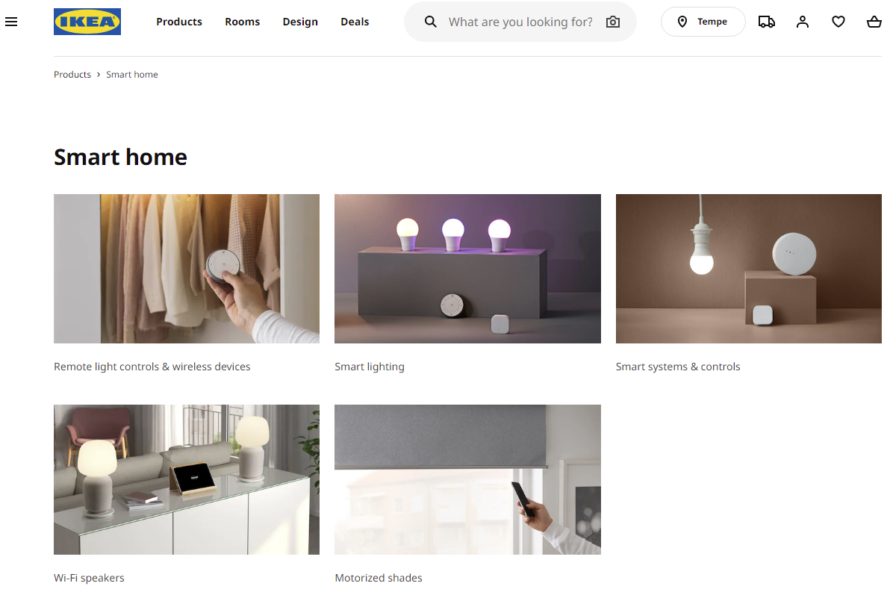
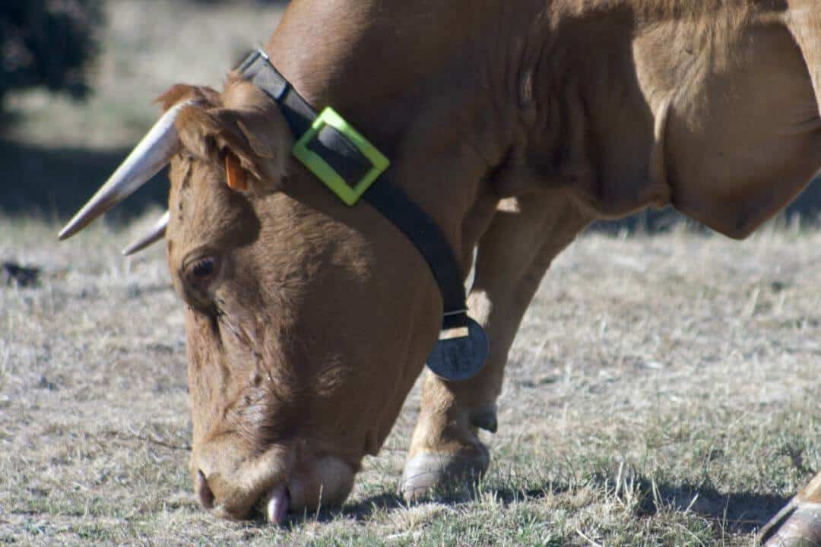
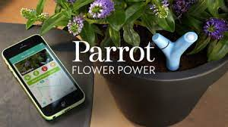
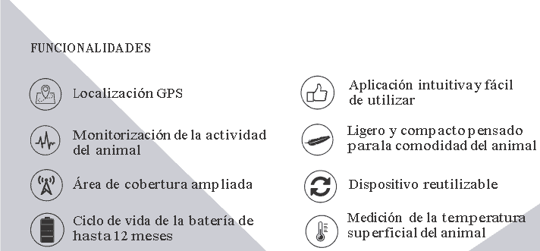
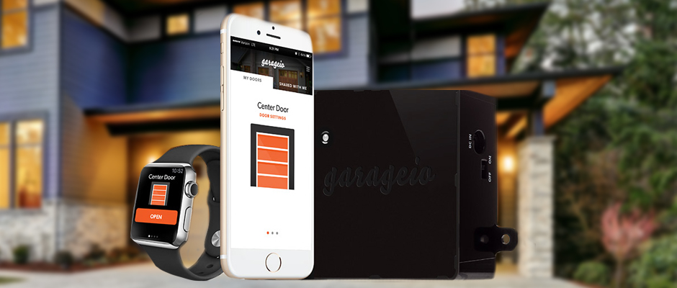
Reguladores de luz Inteligente
Monitoreo de animales LaingHolding
Puertas de Garaje Inteligente garageio

Slide 13

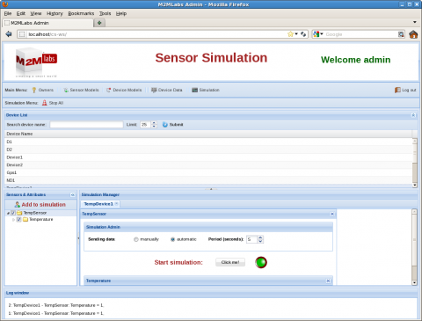

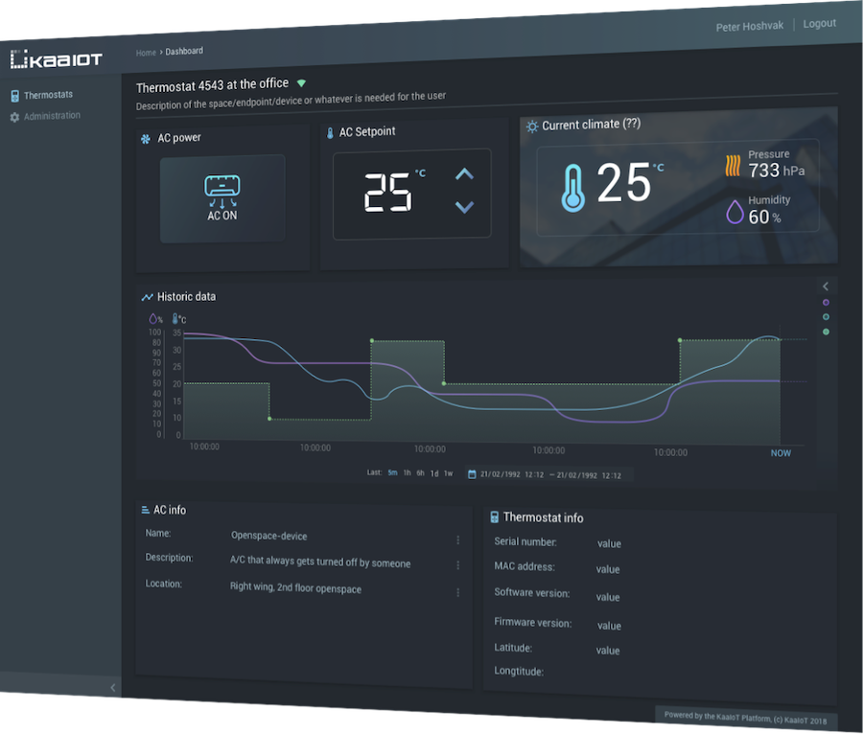



Slide 14
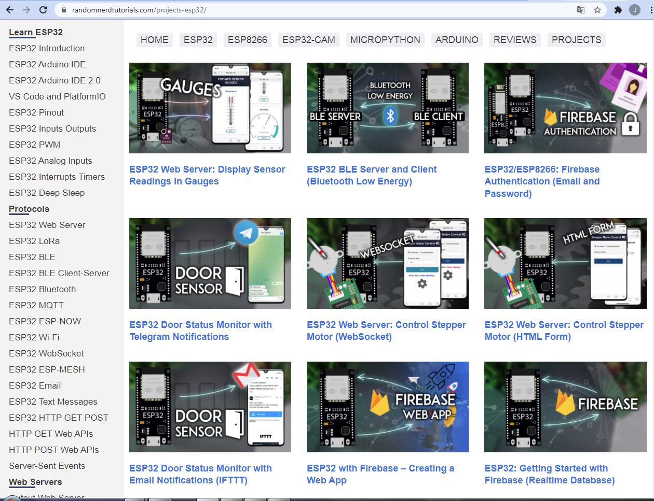
https://randomnerdtutorials.com/projects-esp32/
Figura6. Autoría RandomNerdTutorials.com

Slide 15
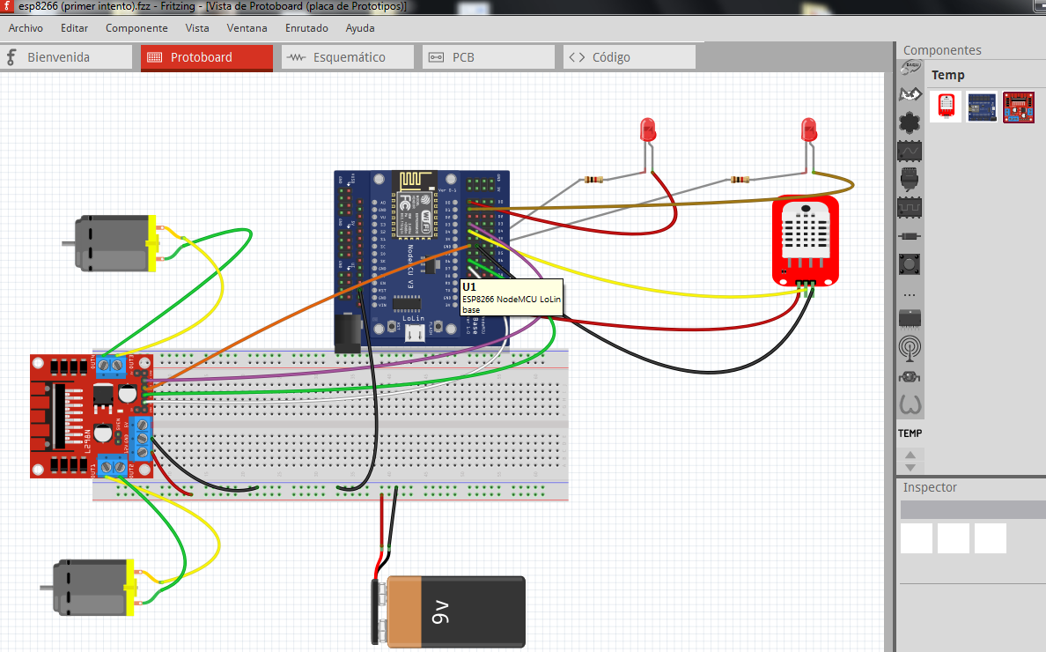
Esquema Fritzing

Slide 16
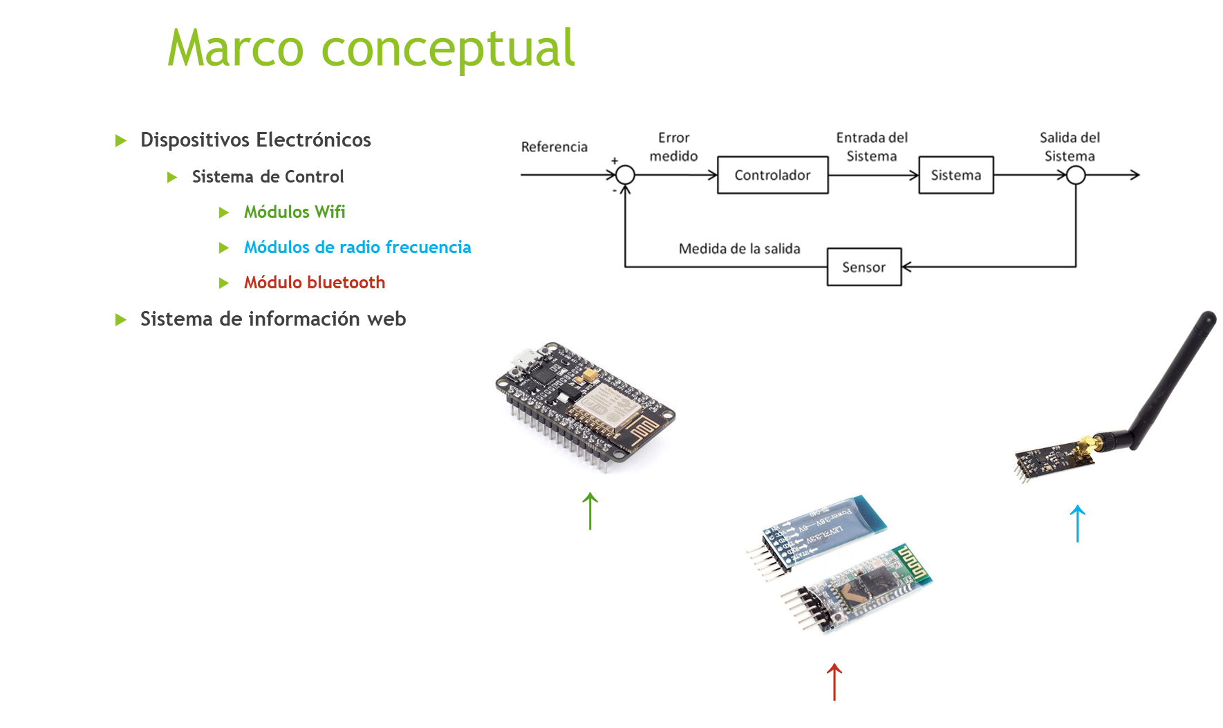

Slide 17
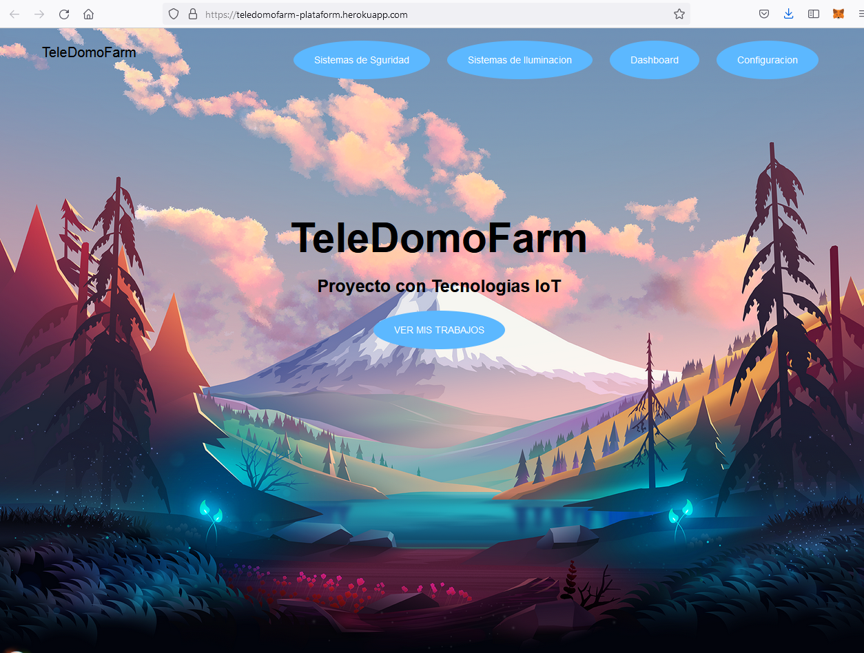
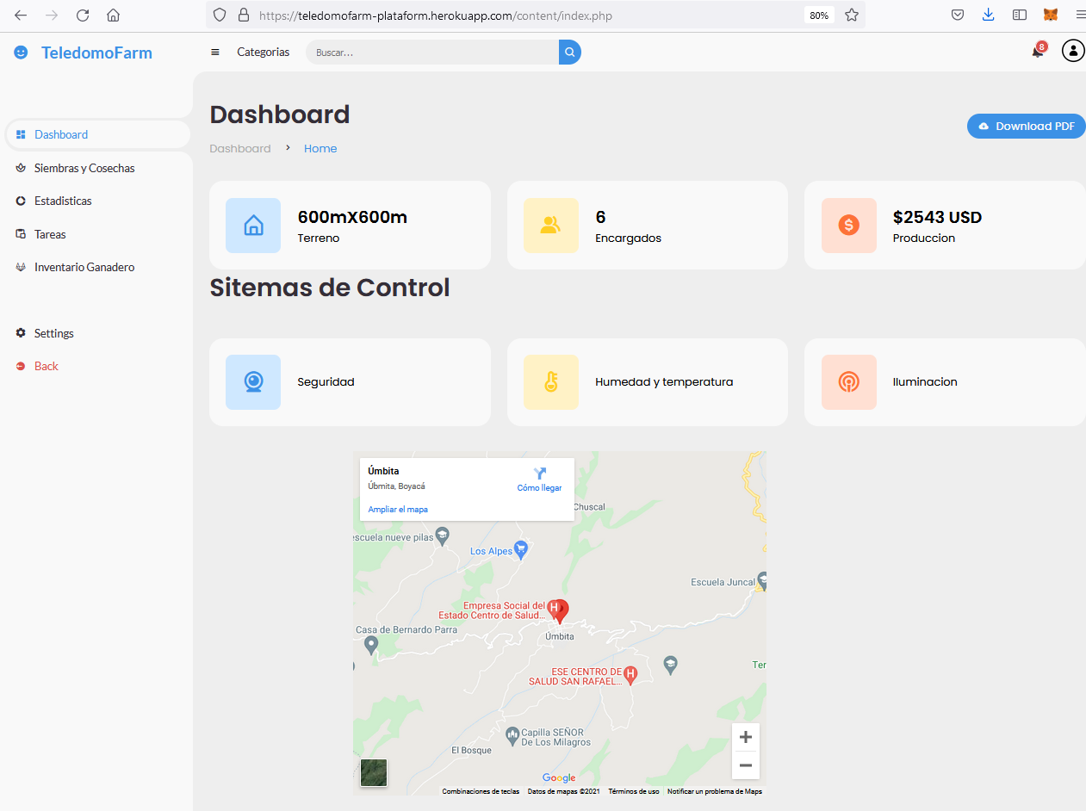
Resultados del avance del proyecto Sistema de información
Figura1. Autoría Juan Pablo Guerra Porras
Figura2. Autoría Juan Pablo Guerra Porras

Slide 18
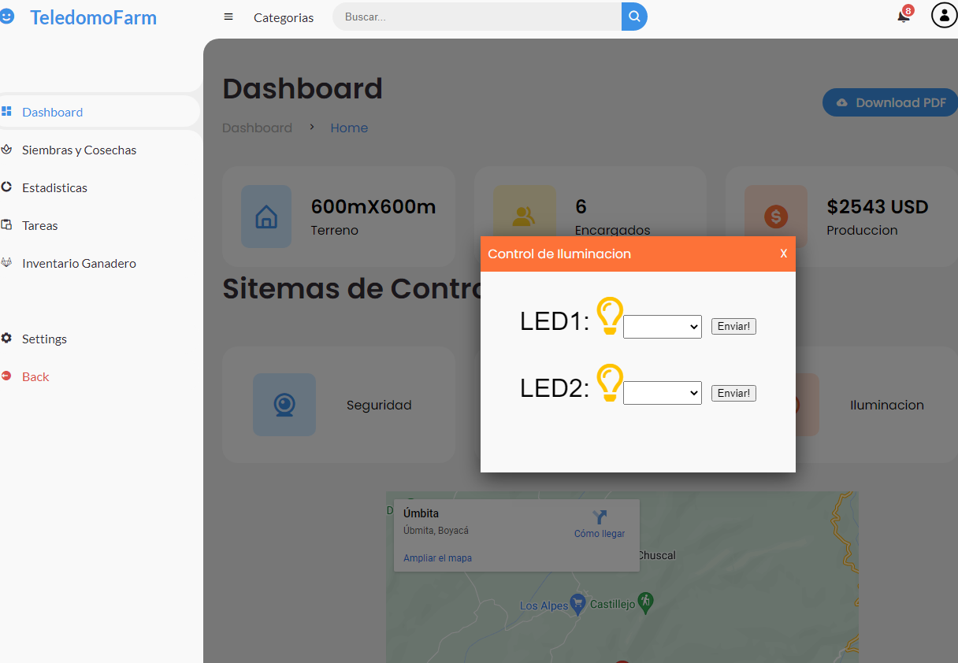
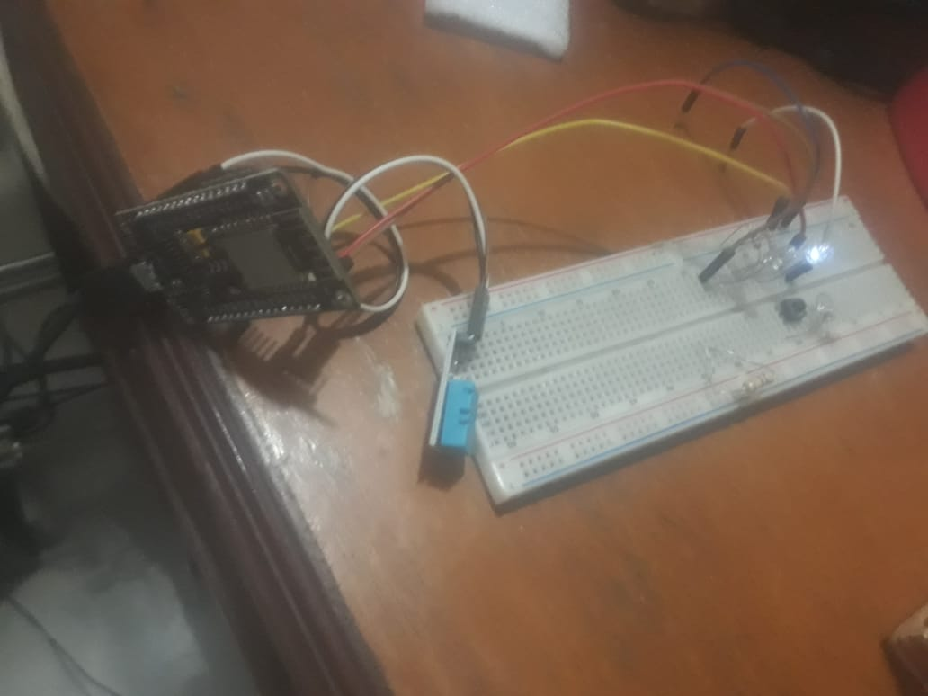
Resultados del avance del proyecto Control de Iluminacion.

Slide 19
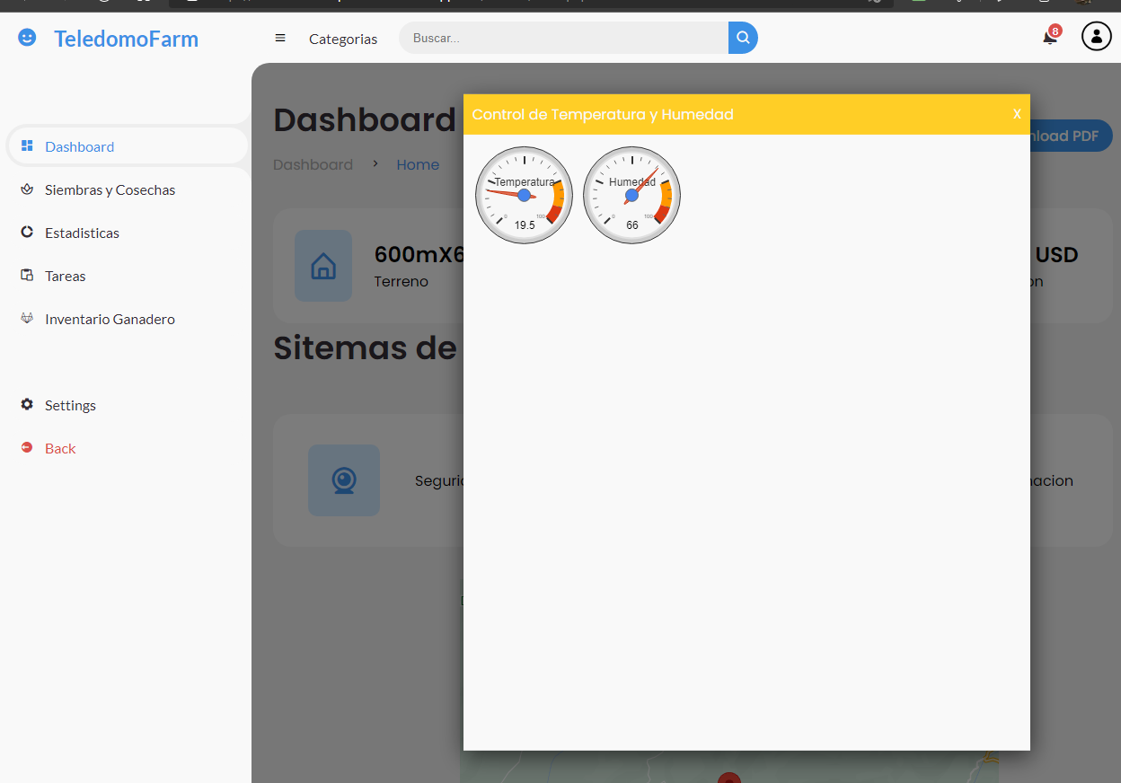
Resultados del avance del proyecto Control de Humedad -Temperatura.
Figura. Autoría Juan Pablo Guerra Porras

Slide 20
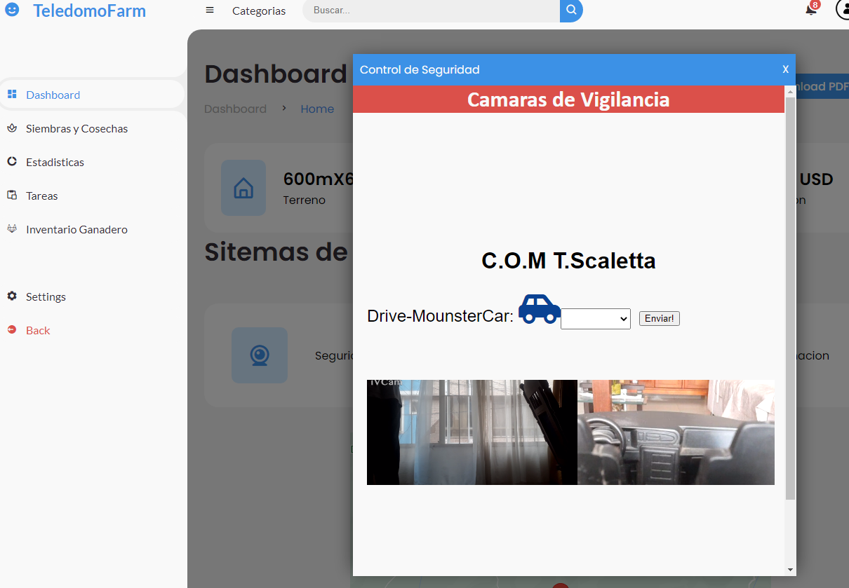
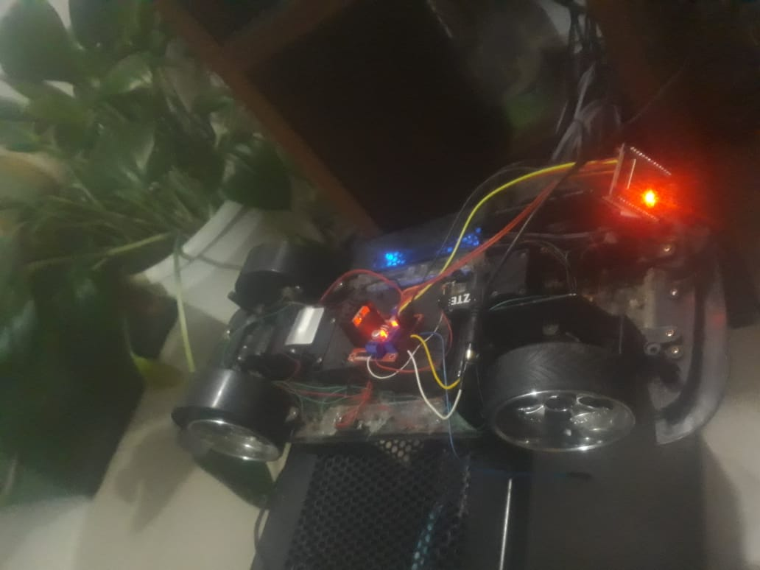
Resultados del avance del proyecto Control de Seguridad.
Figura4. Autoría Juan Pablo Guerra Porras
Figura3. Autoría Juan Pablo Guerra Porras

Slide 21
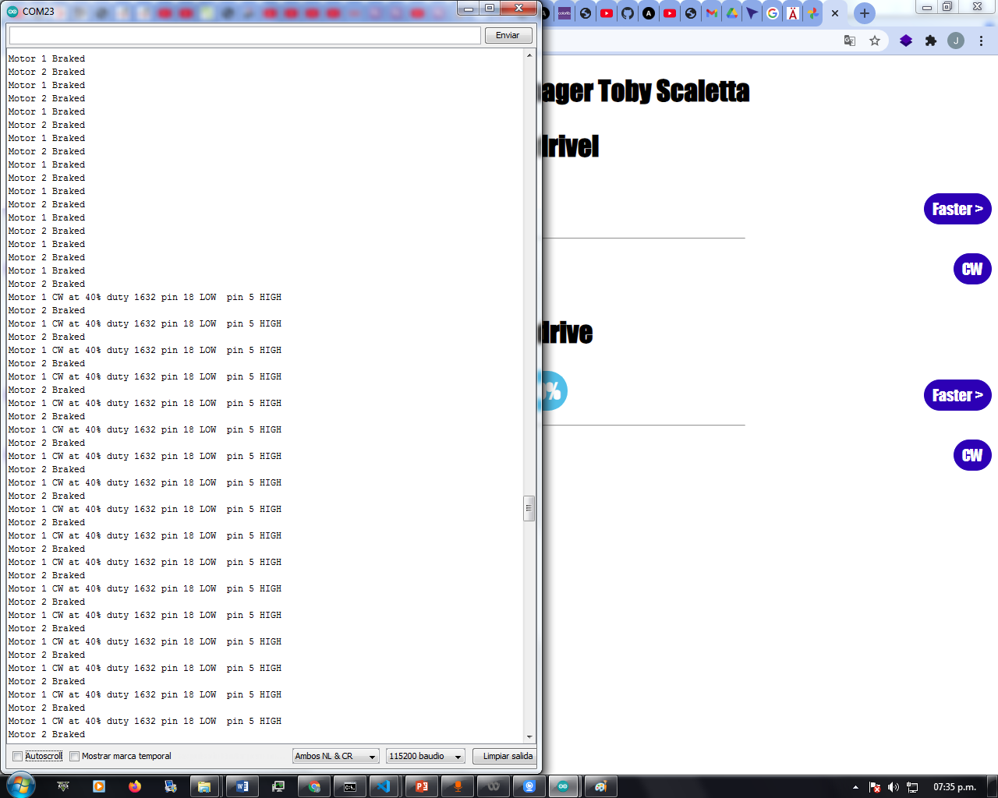
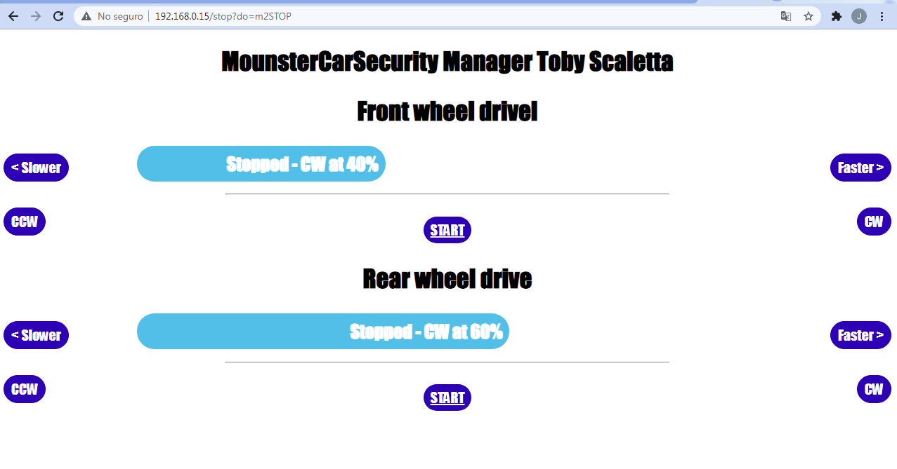
Resultados del avance del proyecto Control de Iluminación. Control de Humedad y temperatura.

Slide 22

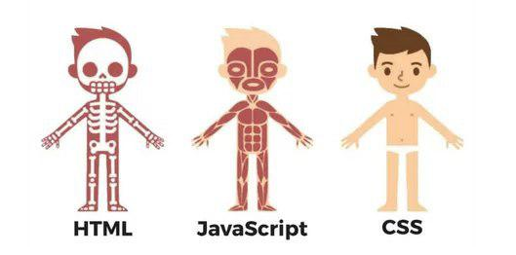
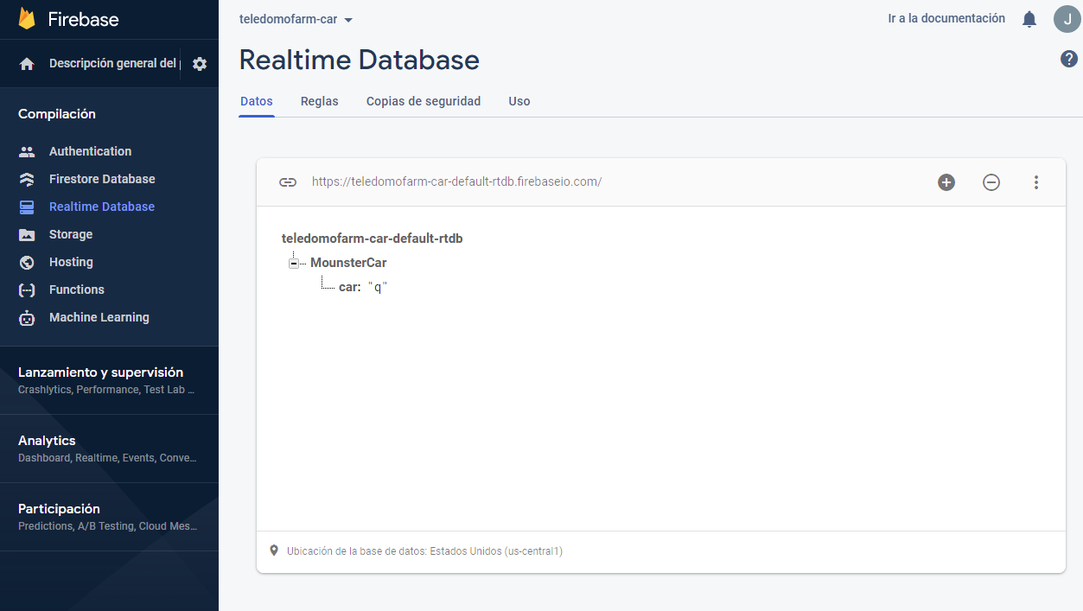
Desarrollo

Slide 23
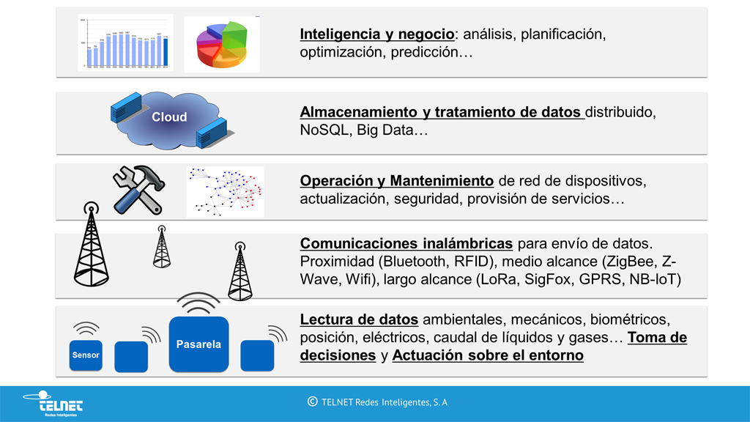
Beneficios de IoT y Domotica
Figura 7.http://www.ccapitalia.net/?p=1809

Slide 24
Conclusiones
Aunque el Proyecto “TeleDomoFarm” no se a concluido al
100% de su implementación se muestran grandes avances en
la práctica. Se observa que con la ayuda de las tecnología IoT en la
interconexión y conjunción de elementos los cuales sus
funciones son gracias a los objetos físicos que se gestionan
con la misma interconectividad por medio de internet,
utilizando diversas tecnologías o en este caso un sistema de
información no solo utilizable para el tema agrario se facilita
de una forma eficiente el control y manejo de las cosas.

Slide 25
Lecciones Aprendidas
En la parte del montaje y elaboración del circuito con el ESP-32 SE debían tener precauciones como circuitos auxiliares con fuentes independientes para evitar estropear el COM.
Por errores electrónicos se retraso el tiempo de entrega completa del proyecto.
Se disminuyeron las limitantes que se tenían propuestas en el proyecto por el tema económico.
Demasiado tiempo transcurrido en el inicio de la fase de formulación del proyecto produciendo modificaciones de los supuestos de este mismo.
Con herramientas básicas y no sofisticadas de programación se cumplió con la gran mayoría de las tareas propuestas en el proyecto.

Slide 26
Referencias Bibliogradficas
AgriculturaElectronica. 2020. arduino. [En línea] 15 de 09 de 2020. https://create.arduino.cc/projecthub/agriculturaelectronica.
Cardona, Orlando. 2007. gestiopolis. [En línea] 06 de 07 de 2007. https://www.gestiopolis.com/que-significa-domotica-sus-alcances-y-utilidad/.
carlos2987. 2005. sites.google.com/site/carlosraulsan2987.
[En línea] 25 de 02 de 2005. https://sites.google.com/site/carlosraulsan2987/home/tecnologias-inalambricas/unidad-3/domotica.
casadomo. 1993. monografias. [En línea] 12 de 03 de 1993. https://www.monografias.com/trabajos93/aplicaciones-domotica/image003.jpg.
Castellanos, Eduardo Izaguirre. 2012. elibro. https://elibro.com/. [En línea] 2012.
[Citado el: 13 de 09 de 2021.] https://elibro-net.ucatolica.basesdedatosezproxy.com/es/ereader/ucatolica/124330?page=18. 978-959-250-780-7.
2010. De tecnologia y otras cosas. [En línea] 15 de 05 de 2010. https://dtyoc.files.wordpress.com/2015/11/domotica-2.jpg.
García, Carlos Raúl Sánchez. 1993. Tecnologias Informaticas. [En línea] 12 de 03 de 1993. https://www.monografias.com/trabajos93/aplicaciones-domotica/image003.jpg.
locurainformaticadigital. 2021. locurainformaticadigital. [En línea] 15 de 05 de 2021
. https://www.locurainformaticadigital.com/2018/07/17/topologia-de-red-malla-estrella-arbol-bus-anillo/.
Seuba, Manuel Lopez i. 2019. www-alphaeditorialcloud-com. alphaeditorialcloud. [En línea] Julio de 2019. [Citado el: 13 de 10 de 2021.]
https://www-alphaeditorialcloud-com.ucatolica.basesdedatosezproxy.com/reader/internet-de-las-cosas?location=7. 9788499648354.
sigmaelectronica. 2018. sigmaelectronica. [En línea] 5 de 06 de 2018. https://www.sigmaelectronica.net/.

Slide 27
Technology Infographics
Saturn
It’s a gas giant and has several rings
Jupiter
Jupiter is the biggest planet of them
Neptune
It’s the farthest planet from the Sun
Mars
Despite being red, Mars is cold
Mercury
It’s the closest planet from the Sun
Earth
Earth is the third planet from the Sun

Slide 28
Beneficios de IoT y Domotica
Jupiter
Jupiter is the biggest planet in the Solar System
Mars
Despite being red, Mars is actually a cold place
Neptune
Neptune is the farthest planet from the Sun

Slide 29
Technology Infographics
Mars
Jupiter
Despite being red, Mars is actually cold
25%
35%
Jupiter is the biggest planet of them all
Earth
Neptune
Earth is the third planet from the Sun
10%
40%
Neptune is the farthest planet from the Sun

Slide 30
Technology Infographics
Jupiter
Saturn
Jupiter is the biggest planet of them all
03
04
It’s a gas giant and has several rings
Mars
02
05
Neptune
Despite being red, Mars is actually cold
It’s the farthest planet from the Sun
Earth
01
06
Mercury
Earth is the third planet from the Sun
It’s the closest planet from the Sun

Slide 31
Technology Infographics
Jupiter
Mars
Saturn
Neptune
Jupiter is the biggest planet of them all
Despite being red, Mars is actually a cold place
Saturn is a gas giant and has several rings
Neptune is the farthest planet from the Sun

Slide 32
1
Jupiter
Jupiter is the biggest planet of them all
4
Neptune
Technology Infographics
Neptune is the farthest planet from the Sun
2
Mars
Despite being red, Mars is actually cold
5
Earth
Earth is the third planet from the Sun
3
Saturn
Saturn is a gas giant and has several rings

Slide 33
Technology Infographics
1
6
Jupiter
Saturn
Jupiter is the biggest planet of them all
It’s a gas giant and has several rings
2
5
Mars
Neptune
Despite being red, Mars is actually cold
It’s the farthest planet from the Sun
3
4
Earth
Mercury
Earth is the third planet from the Sun
It’s the closest planet to the Sun

Slide 34
Technology Infographics
Jupiter
Mercury
Jupiter is the biggest planet of them all
It’s the closest planet of the Sun
Neptune
Earth
It’s the farthest planet from the Sun
It’s the third planet from the Sun
Saturn
Mars
It’s a gas giant and has several rings
It’s actually a cold place

Slide 35
Technology Infographics
Saturn
Earth
It’s a gas giant and has several rings
It’s the third planet from the Sun
Jupiter
Neptune
Mercury
Jupiter is the biggest planet of them all
It’s the farthest planet from the Sun
It’s the closest planet of the Sun

Slide 36
Technology Infographics
Jupiter
Saturn
Jupiter is the biggest planet of them all
It’s a gas giant and has several rings
Mars
Neptune
Despite being red, Mars is actually cold
It’s the farthest planet from the Sun

Slide 37
Technology Infographics
Jupiter is the biggest planet of all the solar system
Despite being red, Mars is actually a really cold place
Jupiter
Mars
Saturn
Saturn is a gas giant and has several ring around it
Venus
Earth
Venus is the second planet from the Sun and has a beautiful name
It’s the third planet from the Sun and the only known to harbor life

Slide 38
Technology Infographics
Jupiter
Mercury
Jupiter is the biggest planet of them all
It’s the closest planet of the Sun
Neptune
Earth
It’s the farthest planet from the Sun
It’s the third planet from the Sun
Saturn
Mars
It’s a gas giant and has several rings
It’s actually a cold place

Slide 39
Technology Infographics
Neptune
Earth
It’s the farthest planet from the Sun
It’s the third planet from the Sun
Jupiter
Mercury
Jupiter is the biggest planet of them all
It’s the closest planet of the Sun

Slide 40
Technology Infographics
Mercury
It’s the closest planet of the Sun
Earth
It’s the third planet from the Sun
Mars
Despite being red, Mars is a cold place

Slide 41
Technology Infographics
Jupiter
Jupiter is the biggest planet of them all
Earth
2
4
It’s the third planet from the Sun
Neptune
It’s the farthest planet from the Sun
1
3
5
Mars
It’s actually a cold place
Saturn
It’s a gas giant and has several rings

Slide 42
Technology Infographics
Jupiter
Mercury
Jupiter is the biggest planet of them all
It’s the closest planet of the Sun
Neptune
Earth
It’s the farthest planet from the Sun
It’s the third planet from the Sun
Saturn
Mars
It’s a gas giant and has several rings
It’s actually a cold place

Slide 43
Technology Infographics
Jupiter
Mercury
Jupiter is the biggest planet of them all
It’s the closest planet of the Sun
Neptune
Earth
It’s the farthest planet from the Sun
It’s the third planet from the Sun
Saturn
Mars
It’s a gas giant and has several rings
It’s actually a cold place

Slide 44
Technology Infographics
Neptune
Venus
It’s the farthest planet from the Sun
It’s the closest planet of the Sun
Jupiter
Earth
Mars
Jupiter is the biggest planet of them all
It’s the third planet from the Sun
Despite being red, it’s actually a cold place

Slide 45
Technology Infographics
Neptune
It’s the farthest planet from the Sun
Jupiter
Earth
Jupiter is the biggest planet of them all
It’s the third planet from the Sun
Mars
Mercury
Despite being red, it’s actually a cold place
It’s the closest planet from the Sun

Slide 46
Technology Infographics
1
3
5
Jupiter is the biggest planet of them all
Saturn is a gas giant and has several rings
Mercury is the closest planet of the Sun
2
4
6
Neptune is the farthest planet from the Sun
Earth is the third planet from the Sun
Despite being red, it’s actually a cold place

Slide 47
Technology Infographics
1
Jupiter
Jupiter is the biggest planet of them all
2
Mars
Despite being red, it’s actually a cold place
3
Saturn
Saturn is a gas giant and has several rings
4
Mercury
Mercury is the closest planet to the Sun
5
Neptune
Neptune is the farthest from the Sun

Slide 48
Technology Infographics
Jupiter
Neptune
Saturn
Mars
Mercury
Earth
Jupiter is the biggest planet
Neptune is the farthest planet
Saturn has several rings
Mars is actually a cold place
It’s the closest planet of the Sun
Earth is the third planet to the Sun

Slide 49
Technology Infographics
Jupiter
Saturn
Jupiter is the biggest planet of them all
It’s a gas giant and has several rings
Neptune
Mercury
It’s the farthest planet from the Sun
It’s the closest planet of the Sun

Slide 50
Technology Infographics
Mercury
It’s the closest planet of the Sun
Jupiter
Neptune
Jupiter is the biggest planet of them all
It’s the farthest planet from the Sun
Saturn
Mars
It’s a gas giant and has several rings
It’s actually a cold place
Earth
It’s the third planet from the Sun

Slide 51
Technology Infographics
Jupiter
Mercury
Jupiter is the biggest planet of them all
It’s the closest planet of the Sun
Neptune
Earth
It’s the farthest planet from the Sun
It’s the third planet from the Sun
Saturn
Mars
It’s a gas giant and has several rings
Despite being red, it’s actually a cold place

Slide 52
Technology Infographics
Jupiter
Saturn
Jupiter is the biggest planet
Saturn has several rings
Mars
Earth
Mars is actually a cold place
Earth is the the third planet
Neptune
Mercury
Neptune is the farthest planet
Mercury is the smallest planet

Slide 53
Instructions for use
In order to use this template, you must credit Slidesgo and Freepik in your final presentation and include links to both websites.
You are allowed to:
- Modify this template.
- Use it for both personal and commercial projects.
You are not allowed to:
- Sublicense, sell or rent any of Slidesgo Content (or a modified version of Slidesgo Content).
- Distribute Slidesgo Content unless it has been expressly authorized by Slidesgo.
- Include Slidesgo Content in an online or offline database or file.
- Offer Slidesgo templates (or modified versions of Slidesgo templates) for download.
- Acquire the copyright of Slidesgo Content.
For more information about editing slides, please read our FAQs or visit Slidesgo School:
https://slidesgo.com/faqs and https://slidesgo.com/slidesgo-school

Slide 54
Infographics
You can add and edit some infographics to your presentation to present your data in a visual way.
Choose your favourite infographic and insert it in your presentation using Ctrl C + Ctrl V or Cmd C + Cmd V in Mac.
Select one of the parts and ungroup it by right-clicking and choosing “Ungroup”.
Change the color by clicking on the paint bucket.
Then resize the element by clicking and dragging one of the square-shaped points of its bounding box (the cursor should look like a double-headed arrow). Remember to hold Shift while dragging to keep the proportions.
Group the elements again by selecting them, right-clicking and choosing “Group”.
Repeat the steps above with the other parts and when you’re done editing, copy the end result and paste it into your presentation.
Remember to choose the “Keep source formatting” option so that it keeps the design. For more info, please visit Slidesgo School.

